Slide 1
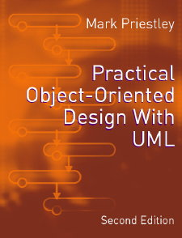
PRACTICAL
OBJECT-ORIENTED
DESIGN WITH UML
2e
Chapter 1:
Introduction to UML

Slide 2
Software Development
Many software projects end in failure - why?
A poor software development process is one possible cause of project failure
Many process models have been produced describing recommended processes
Typical process models define:
  An ordered set of development activities
  The deliverables of the process

Slide 3
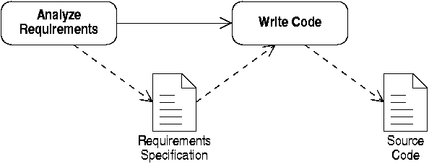
A Simple Process Model
In the simplest cases, code is written direct from some statement of requirements

Slide 4
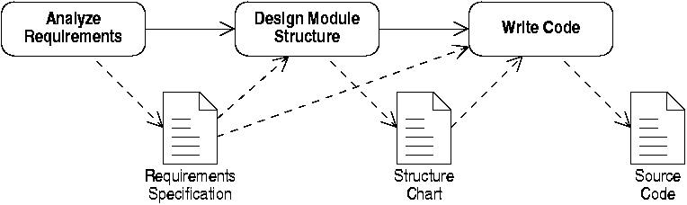
A More Complex Process
On larger projects, intermediate pieces of documentation are produced

Slide 5
Models
Documents like structure charts are known as models
They give an abstract view of the system's structure
  This makes it easier to understand
Many different types of model in use, eg:
  Flowcharts
  Dataflow diagrams

Slide 6
Analysis and Design
Models can be used to:
  Describe the structure of a real-world application (analysis)
  Describe the structure of a proposed software system (design)
Object-oriented methods use the same notation for both purposes
  Older structured methods used different analysis and design notations

Slide 7
Methodology
A term (mis)used to mean “a strategy for successfully developing software”
Methodologies offer two forms of guidance
  What process to follow
  What notation to use
Different classes of methodology are in use
  Structured methods
  Object-oriented methods

Slide 8
UML: Unified Modelling Language
UML is a notation suitable for use with object-oriented methods
UML does not define a process
It evolved from three earlier methods
  Grady Booch's method
  OMT: James Rumbaugh et al
  Objectory: Ivar Jacobson
Now the industry-standard design notation

Slide 9
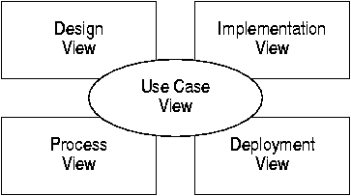
'4+1 View Model'
UML can describe a system from a number of perspectives, or views
Views highlight aspects of the system important to different stakeholders

Slide 10
Views
Use case view: describes behaviour
  Useful for analysts, users and testers
Design view: describes logical structure
  Useful for programmers as basis for coding
Implementation view: describes components
  Useful for configuration management etc
Process and deployment views
  Describe concurrency and distribution

Slide 11
Some UML Terminology
Model
  Sometimes, the information in a view
  Sometimes, all the information about the system
Model element
  A modelling 'atom': e.g. a class or a method call
Diagram
  A graphical presentation of a collection of model elements

Slide 12
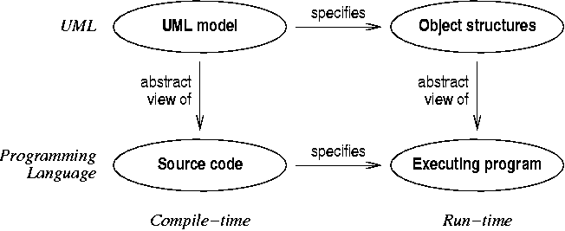
Design models and code
UML is based on the same object model as object-oriented programming languages

Slide 13
UML Pragmatics
A UML model is like an abstract program
  UML can describe the structure of source code
  UML can describe the run-time behaviour
UML is not (normally) executable
  Tools exist to support moving between UML and code
UML should be used in conjunction with a suitable software development process

